Slide 1
70-535 Objective 1
Design Compute Infrastructure 20-25% of Exam
3-1
Notes:
Presentation: 60 minutes
Lab: 60 minutes
After completing this module, students will be able to:
Design an availability set for one or more virtual machines
Describe the differences between fault and update domains.
Author a VM Scale Set ARM template.
Join a virtualized machine to a domain either in Azure or on a hybrid network.
Required materials
To teach this module, you need the Microsoft PowerPoint file: 20535A_03.pptx.
Preparation tasks
To prepare for this module, you should:
Read all of this module’s materials.
Practice performing the demonstrations and labs.
Work through the Module Review and Takeaways section to determine how you will use the information to reinforce student learning and promote knowledge transfer to on-the-job performance.
As you prepare for this class, it is imperative that you complete the labs yourself. This gives you an understanding of how the labs work and the concepts that each covers, so that you can provide meaningful hints to students who might have issues. Furthermore, it will help guide your lecture to ensure that you discuss the concepts that the lab covers.
The Azure portal is continually being improved, and the user interface might have updated since this module was written. Therefore, before teaching this module, familiarize yourself with the latest version of the Azure portal.
20535A
3: Building Azure IaaS-Based Server Applications

Slide 2
Lesson 1: Design Pattern Resources
Why Patterns? Microsoft Patterns & Practices Azure Architecture Center
1-2
Notes:
20535A
1: Application Architecture Patterns in Azure

Slide 3
Why Patterns?
Most problems are already solved by other professionals in the industry
Years of experience and research have defined best practices and the “best practice” when developing new solutions
Most patterns are platform-agnostic
1-2
Notes:
20535A
1: Application Architecture Patterns in Azure

Slide 4
Microsoft Patterns & Practices
Engineering focused group at Microsoft
Collects real-world scenarios from customers
Engineers solutions using best-practices
Analyze trends and services used by the community
Shares findings using
GitHub
Whitepapers
Conference Sessions
http://docs.microsoft.com
1-3
Notes:
20535A
1: Application Architecture Patterns in Azure

Slide 5
Cloud Design Patterns
The Cloud Design Patterns is a collection developer-oriented prescriptive architecture guidance
Includes topics and patterns that help you design your cloud solutions
Patterns are platform and framework-agnostic
Examples are provided in the context of Azure and C#
1-3
Notes:
20535A
1: Application Architecture Patterns in Azure

Slide 6
Patterns & Practices on GitHub
Microsoft Patterns & Practices shares much of their documentation, projects and findings today on GitHub:
https://github.com/mspnp
For example, the Microservices Reference Implementation shares best practices when designing a microservices solution running on Azure using Kubernetes:
https://github.com/mspnp/microservices-reference-implementation
1-3
Notes:
Navigate to the Microservices page and scroll down to show the reference architecture diagram.
The reference solution using Azure Container Service.
20535A
1: Application Architecture Patterns in Azure

Slide 7
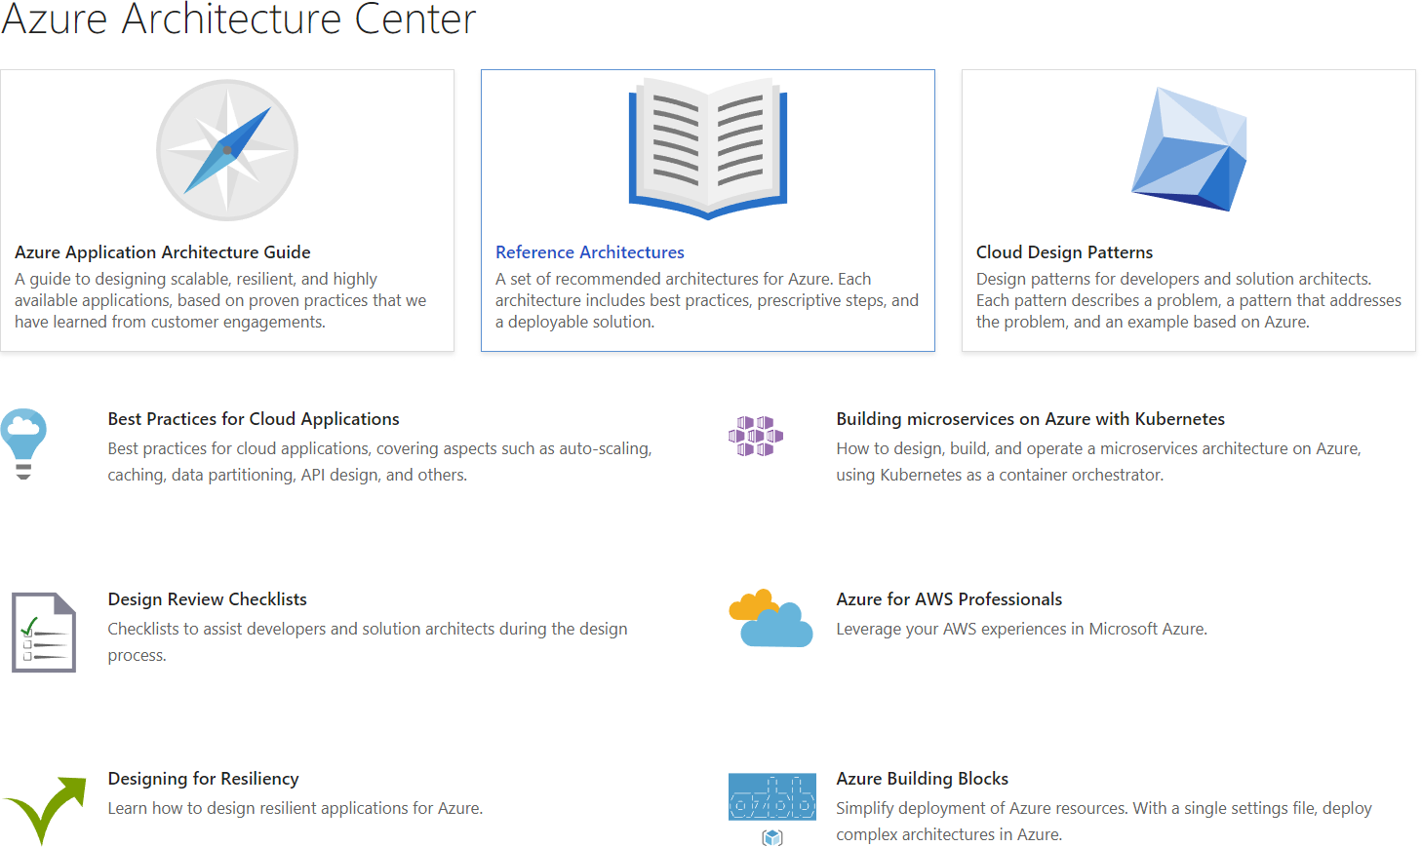
Azure Architecture Center
Landing page for reference architectures, patterns and guidance for solutions on the Azure Platform
https://docs.microsoft.com/azure/architecture/
1-4
Notes:
20535A
1: Application Architecture Patterns in Azure

Slide 8
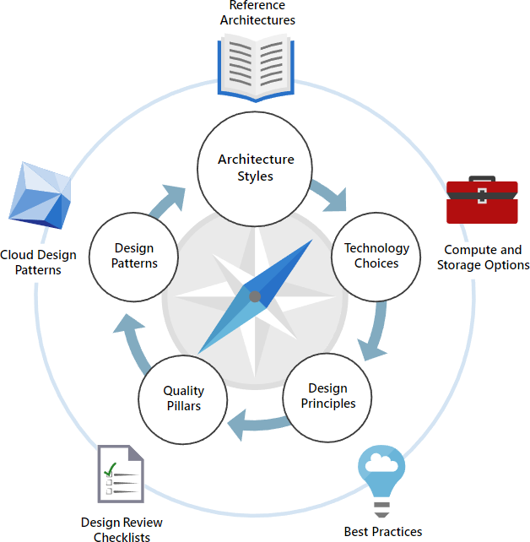
Azure Architecture Center Guide
The Architecture Center features an all-up guide to creating solutions that are scalable, resilient and highly available
https://docs.microsoft.com/azure/architecture/guide/
1-4
Notes:
Show the students the webpage for the guide.
20535A
1: Application Architecture Patterns in Azure

Slide 9
Lesson 1: ARM Templates
Azure Resource Manager JSON
2-2
Notes:
20535A
2: Deploying Resources with Azure Resource Manager

Slide 10
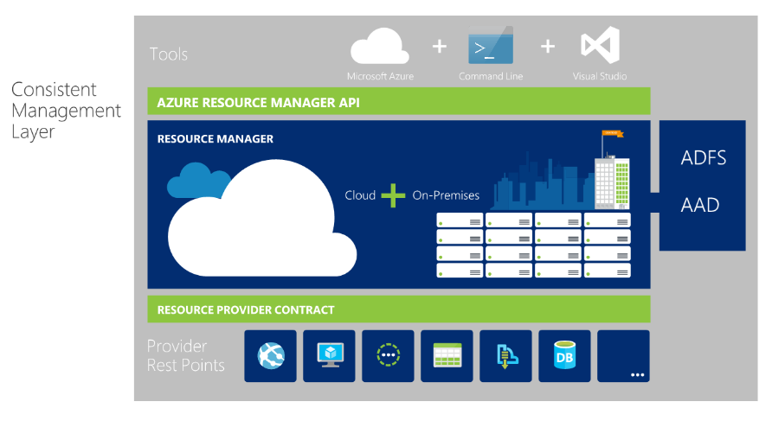
Azure Resource Manager
2-2
Notes:
You use a template -- a resource model of the service -- to create a resource group with the resources you specified above. After you author the template, you can manage and deploy that entire resource group as a single logical unit. There are three primary concepts in Resource Manager:
Resource: A resource is merely a single service instance in Azure. Most services in Azure have a direct representation as a resource. For example, a Web App instance is a resource. An App Service Plan is also a resource. Even a SQL Database instance is a resource.
Resource Group: A resource group is a group of resources in the logical sense. For example, a Resource Group composed of a Network Interface Card (NIC), a Virtual Machine compute allocation, a Virtual Network, and a Public IP Address creates what we would logically consider a “Virtual Machine.”
20535A
2: Deploying Resources with Azure Resource Manager

Slide 11
Azure Resource Manager Templates
Provide a scalable, repeatable method for deploying Azure resources
All resources in the ARM model are built using JSON templates
https://github.com/Azure/azure-quickstart-templates
2-2
Notes:
Resource Group Template: Every resource group deployment is completed using a JSON file known as the resource group template. This JSON file declaratively describes a set of resources. The deployment adds the new resources to a new or existing resource group. For example, a template could contain the configuration necessary to create 2 API App instances, a Mobile App instance and a Cosmos DB instance.
20535A
2: Deploying Resources with Azure Resource Manager

Slide 12
Deploying Resources
PowerShell
Cross Platform Command-Line Interface
Client Libraries
Visual Studio
Portal template deployment
All use the REST API: The REST API is available here: https://docs.microsoft.com/rest/api/resources
2-3
Notes:
Interacting with Resource Manager
You can use Resource Manager in a variety of different ways including:
PowerShell: There are PowerShell CmdLets already available to allow you to manage your services in the context of resources and resource groups.
Cross-Platform Command-Line Interface: This CLI allows you to manage your Azure resources from many different operating systems.
Client Libraries: There are client libraries already available for various programming frameworks/languages to create resources and resource groups in Azure.
Visual Studio: Visual Studio 2015 ships with a Resource Manager project type that allows you to create a resource group template by either manually modifying JSON (with schema intellisense) or use scaffolding to update your JSON template automatically.
Portal template deployment: In the portal, you can use the Template Deployment option in the Marketplace to deploy a Resource Group from a template.
REST API: All the above options use the REST API to create your resources and resource groups. If you prefer to create resources without a library, you can always use the REST API directly. The REST API is available here: https://docs.microsoft.com/rest/api/resources/
20535A
2: Deploying Resources with Azure Resource Manager

Slide 13
JSON
What is JSON?
JavaScript Object Notification (JSON) is a method for passing data and objects in a formatted style
Similar to XML but “lightweight”
2-4
Notes:
JSON is a, text-based data exchange format (see RFC 4627).
JSON is human-readable, platform independent, and enjoys a wide availability of implementations, similar to XML
Data formatted according to the JSON standard is lightweight and can be parsed by JavaScript implementations with ease. This makes it a perfect choice for data exchange.
JSON can be used in virtually any situation where applications need to exchange or store structured information as text.
Formatting of JSON is below:
Curly brackets act as 'containers’
Square brackets holds arrays or data
Names and values are separated by colons
Array elements are separated by a comma
20535A
2: Deploying Resources with Azure Resource Manager

Slide 14
What Is a JSON Template?
{
"$schema": "http://schema.management.azure.com/schemas/2015-01-01/deploymentTemplate.json#",
"contentVersion": "1.0.0.0",
"parameters": {
},
"variables": {
},
"resources": [
],
"outputs": {
}
}
2-4
Notes:
A JSON template is based on a SCHEMA.
This and the Content version sections are mandatory.
The Parameters and Variables sections are optional as is the output.
A JSON template with no resources section, would not deploy anything.
20535A
2: Deploying Resources with Azure Resource Manager

Slide 15
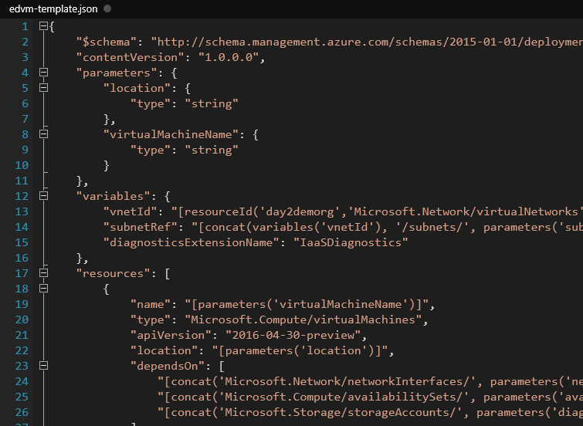
Template Complexity
2-4
Notes:
There are many complexities in a detailed resource template.
To be able to architect solutions and applications within the Azure ecosystem a through understanding of JSON and the template structure as well as methods of manipulation and deployment are required.
As an example, you can see in this slide the Virtual Machine resource using the Microsoft.Compute /VirtualMachines resource provider has several items on which it depends (line 23 onwards).
Nesting is quite common also.
Building a robust and detailed template is quite a skill.
Azure helps with this by providing an Automation Script item on each resource blade to allow examination and redeployment of current resources.
The rest of this module digs deeper into the Azure Resource Manager and how to maximize its use.
20535A
2: Deploying Resources with Azure Resource Manager

Slide 16
Template Driven Resources
Parameters
Resources
Output
Variables
2-4
Notes:
Advantages Of Using Templates
Templates are generally preferred to manually deploying resources for quite a few reasons:
A template can ensure idempotency. If you deploy an identical template to multiple resource groups, they would functionally be the same.
A template can simplify orchestration as you only need to deploy the template to deploy all of your resources. Normally this would take multiple operations.
A template allows you to configure multiple resources simultaneously and use variables/parameters /functions to create dependencies between resources. For example you can require that a VM is created before a Web App because you need the VM's public IP address for one of the Web App's settings. Another example is to require a Storage account is created before a VM so that you can place the VHDs in that storage account.
Templates can parameterize input and output values so they can be reused across many different scenarios. Templates can also be nested so you can reuse smaller templates as part of a larger orchestration.
20535A
2: Deploying Resources with Azure Resource Manager

Slide 17
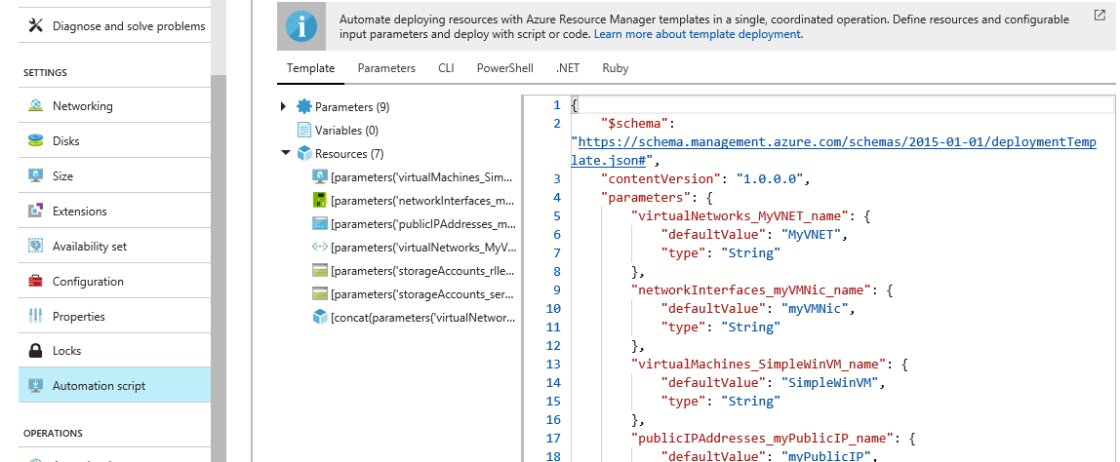
Template Driven Resources
2-4
Notes:
Building a robust and detailed template is quite a skill.
Azure helps with this by providing an Automation Script item on each resource blade to allow examination and redeployment of current resources.
The rest of this module digs deeper into the Azure Resource Manager and how to maximize its use.
20535A
2: Deploying Resources with Azure Resource Manager

Slide 18
Module Overview
High Availability Templated Infrastructure Domain-Joined Virtual Machines
3-1
Notes:
20535A
3: Building Azure IaaS-Based Server Applications

Slide 19
Lesson 1: High Availability
Azure Availability Availability Sets Availability Zones
3-1
Notes:
20535A
3: Building Azure IaaS-Based Server Applications

Slide 20
Azure Availability
Azure provides money-backed SLAs for IaaS services:
Two Instances or more in an Availability Set = 99.95%
Single Instance VM using Premium Storage = 99.9%
Decisions should based on cost and availability requirements
3-2
Notes:
Introduce availability.
Reflect on What an Azure region is.
Many datacenters sometimes a fair distance apart.
Also discuss the reason for requirements to achieve the SLA.
20535A
3: Building Azure IaaS-Based Server Applications

Slide 21
Stand-Alone VMs
Single instance VM would gain 99.9% SLA if it complies with:
Premium Storage for all Operating System Disks and Data Disks
Any single instance VM without Premium storage receives no SLA
3-2
Notes:
20535A
3: Building Azure IaaS-Based Server Applications

Slide 22
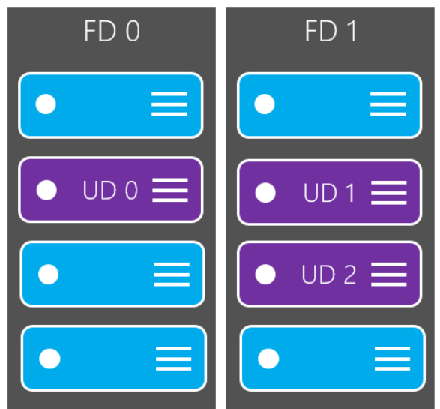
Availability Sets
Availability Sets provide assurance that any multiple instance VM will be available 99.95% of the time
Availability Sets cater for planned and unplanned maintenance using Update Domains and Fault Domains
3-3
Notes:
Discuss what it is.
How it works for azure fabric updates.
What about VM updates?
How faults are dealt with – look at maximum update and fault domains within regions – they differ.
20535A
3: Building Azure IaaS-Based Server Applications

Slide 23
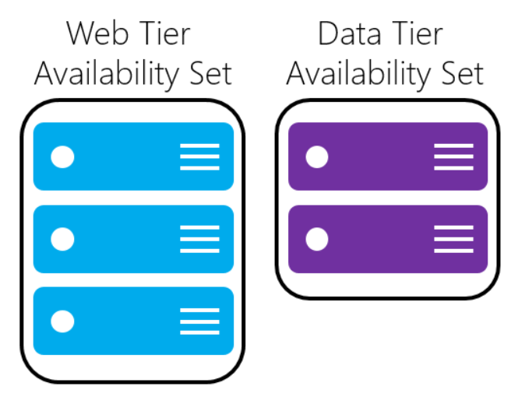
Availability Sets
When planning multiple tier applications use multiple Availability sets, one per tier
3-4
Notes:
Discuss multiple tier apps, including those with multiple services IaaS, PaaS etc.
Worth whiteboarding the architecture and implications of each approach.
20535A
3: Building Azure IaaS-Based Server Applications

Slide 24
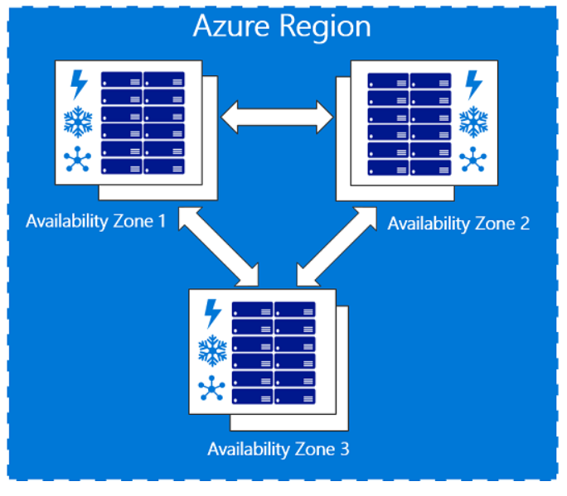
Availability Zones
Service helps to protect resources from datacenter level failures
Provides the ability to place VMs with resilience to the loss of an entire Datacenter building. These are all located within the same Azure region
3-4
Notes:
Discuss Azure AV Zones.
Mention the limits to its locations, resources and machine sizes.
Start a discussion around how this new feature will impact the design of multi tier applications.
20535A
3: Building Azure IaaS-Based Server Applications

Slide 25

Discussion
When would you use multiple Azure Availability Sets in the same application?
Notes:
20535A
3: Building Azure IaaS-Based Server Applications

Slide 26
Lesson 2: Templated Infrastructure
Templated Infrastructure Virtual Machine Scale Sets Virtual Machines vs. Virtual Machine Scale Sets Virtual Machine Scale Set Considerations
3-6
Notes:
20535A
3: Building Azure IaaS-Based Server Applications

Slide 27
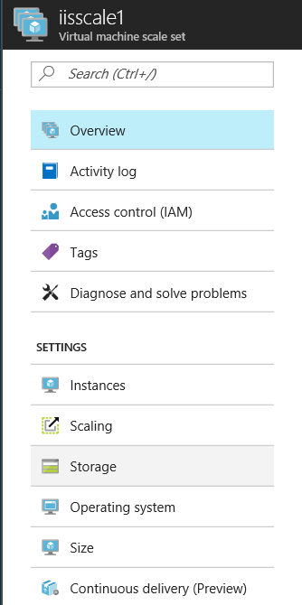
Templated Infrastructure
While ARM templates are an excellent resource, for large scale deployments, other solutions are available:
VM Scale Sets allow true auto scaling to deploy big compute and big data solutions
3-6
Notes:
VM Scale Sets:
Intro into scaling, and other benefits of VM Scale sets.
Reliable rapid deployment at very large scale.
Automatically scale without pre provisioning.
Simple networking adds load balancers and application gateways, NAT etc.
Scale sets provide hyper scale support for containers, web front ends micros services.
20535A
3: Building Azure IaaS-Based Server Applications

Slide 28
Virtual Machine Scale Sets
Scale sets have a number of features:
Deployable with JSON templates just like VMs
Can use Azure Autoscale
No requirement to pre-provision
Load balancer creation
NAT included
3-7
Notes:
Can deploy a Scale set by any standard deployment method:
PowerShell
Azure CLI
Azure Portal
Networking is built in at creation.
Azure Autoscale is available.
20535A
3: Building Azure IaaS-Based Server Applications

Slide 29
Virtual Machines vs. Virtual Machine Scale Sets
Scale Sets:
Easy to grow and shrink on demand
Easy to reimage
Easy to overprovision
Upgrade policies
VMs:
Attach disks to VMs
Attach non-empty disks
Snapshot a VM
Capture a VM Image
Migrate from native to managed disks
Assign IPv6 public IP addresses to individual VM NICs
3-7
Notes:
Design differences VM and Scale Sets
Scale Sets:
Once you specify the scale set configuration, you can simply update the "capacity" property to deploy more VMs in parallel. This is much simpler than writing a script to orchestrate deploying many individual VMs in parallel.
You can use Azure Autoscale to automatically scale a scale set but not individual VMs.
You can reimage scale set VMs but not individual VMs.
You can overprovision scale set VMs for increased reliability and quicker deployment times. You cannot do this with individual VMs unless you write custom code to do this.
You can specify an upgrade policy to make it easy to roll out upgrades across VMs in your scale set. With individual VMs, you must orchestrate updates yourself.
VMs:
You can attach data disks to specific individual VMs, but attached data disks are configured for all VMs in a scale set.
You can attach non-empty data disks to individual VMs but not VMs in a scale set.
You can snapshot an individual VM but not a VM in a scale set.
You can capture an image from an individual VM but not from a VM in a scale set.
You can migrate an individual VM from native disks to managed disks, but you cannot do this for VMs in a scale set.
You can assign IPv6 public IP addresses to individual VM nics but cannot do so for VMs in a scale set. Note that you can assign IPv6 public IP addresses to load balancers in front of either individual VMs or scale set VMs.
20535A
3: Building Azure IaaS-Based Server Applications

Slide 30
Virtual Machine Scale Sets
Connect to an Instance of a VM using RDP through the load balancer
Use Continuous delivery to maintain an application in a VMSS with Visual Studio Team Services
Using managed disks removes storage account considerations from Scale Set creation
3-7
Notes:
Connection to Scale Set VMs.
Either use Loadbalancer RDp or a separate Vm jump box on the same subnet.
Deploying apps to Vmscale sets can be automated using VSTS for continuous delivery.
(github repository supported)
Managed disks – discuss storage account ,limitations and requirements then recommend managed disks in all or almost all situations.
20535A
3: Building Azure IaaS-Based Server Applications

Slide 31
Virtual Machine Scale Set Considerations
Custom Extensions can be used to configure new VM instances when scaling – this can add time to the deployment
Custom Images can be used to deploy all images to the scale set – this scales VMs in a ready to use state
3-8
Notes:
Checklist for using large scale sets
To decide whether your application can make effective use of large scale sets, consider the following requirements:
Large scale sets require Azure Managed Disks. Scale sets that are not created with Managed Disks require multiple storage accounts (one for every 20 VMs). Large scale sets are designed to work exclusively with Managed Disks to reduce your storage management overhead, and to avoid the risk of running into subscription limits for storage accounts. If you do not use Managed Disks, your scale set is limited to 100 VMs.
Scale sets created from Azure Marketplace images can scale up to 1,000 VMs.
Scale sets created from custom images (VM images you create and upload yourself) can currently scale up to 300 VMs.
Layer-4 load balancing with scale sets composed of multiple placement groups requires Azure Load Balancer Standard SKU. The Load Balancer Standard SKU provides additional benefits, such as the ability to load balance between multiple scale sets. Standard SKU also requires that the scale set has a Network Security Group associated with it, otherwise NAT pools will not work correctly. If you need to use the Azure Load Balancer Basic SKU, make sure the scale set is configured to use a single placement group, which is the default setting.
Layer-7 load balancing with the Azure Application Gateway is supported for all scale sets.
A scale set is defined with a single subnet - make sure your subnet has an address space large enough for all the VMs you need. By default a scale set overprovisions (creates extra VMs at deployment time or when scaling out, which you are not charged for) to improve deployment reliability and performance. Allow for an address space 20% greater than the number of VMs you plan to scale to.
If you are planning to deploy many VMs, your Compute vCPU quota limits may need to be increased.
Fault domains and upgrade domains are only consistent within a placement group. This architecture does not change the overall availability of a scale set, as VMs are evenly distributed across distinct physical hardware, but it does means that if you need to guarantee two VMs are on different hardware, make sure they are in different fault domains in the same placement group. Fault domain and placement group ID are shown in the instance view of a scale set VM. You can view the instance view of a scale set VM in the Azure Resource Explorer.
20535A
3: Building Azure IaaS-Based Server Applications

Slide 32
Considerations for “Large” VMSS
Large scale sets over 100 VMs use placement groups – these change load balancing and fault domain characteristics:
Managed Disks
Marketplace images scale to 1,000 VMs
Custom images scale to 300 VMs
Ensure available IP addresses in subnet
Ensure your compute limits are high enough
Fault Domains relate to a single placement group
3-8
Notes:
Checklist for using large scale sets
To decide whether your application can make effective use of large scale sets, consider the following requirements:
Large scale sets require Azure Managed Disks.
Scale sets created from Azure Marketplace images scale up to 1,000 VMs.
Scale sets created from custom images scale up to 300 VMs.
Layer-4 load balancing with scale sets composed of multiple placement groups requires Azure Load Balancer Standard SKU.
Layer-7 load balancing with the Azure Application Gateway is supported for all scale sets.
Scale sets are defined with a single subnet – ensure subnet is large enough.
Ensure your compute limits are high enough (run out of cores).
FD and UD relate to a single placement group.
20535A
3: Building Azure IaaS-Based Server Applications

Slide 33
Discussion
What are the benefits and drawbacks of VMSS for different types of application and services?
3-8
Notes:
20535A
3: Building Azure IaaS-Based Server Applications

Slide 34
Lesson 3: Domain-Joined Virtual Machines
Domain and IaaS Applications Hybrid Connectivity Azure AD Domain Services
3-12
Notes:
20535A
3: Building Azure IaaS-Based Server Applications

Slide 35
Domain and IaaS Applications
Azure provides a number of options for Domains:
Azure AD (and B2B, B2C)
Hybrid ADDS And Azure AD
Azure AD Domain Services
3-12
Notes:
Overview of all Azure AD hybrid options:
Hybrid
Azure AD DS
AAD B2C, AAD B2B
Whiteboard all options for authentication and authorization.
20535A
3: Building Azure IaaS-Based Server Applications

Slide 36
Hybrid Connectivity
Azure AD Connect
Active Directory Federation Services
AD Connect Passthrough
Deploy AD DS to an Azure VM
3-13
Notes:
Detailed option walkthrough.
Install and configure Azure AD connect.
Discuss AD FS options.
Discuss differences with AD connect Passthrough.
20535A
3: Building Azure IaaS-Based Server Applications

Slide 37

Azure AD Hybrid
Passthrough vs. ADFS
3-15
Notes:
Key benefits of using Azure AD Pass-through Authentication:
Great user experience.
Same passwords to sign into both on-premises and cloud-based applications.
Easy to deploy and administer.
No need for complex on-premises ADFS deployment.
A lightweight agent to be installed on-premises.
No management overhead. Automatic bug fixes.
Secure.
On-premises passwords never stored in the cloud in any form.
The agent only makes outbound connections from within your network. No perimeter required.
20535A
3: Building Azure IaaS-Based Server Applications

Slide 38
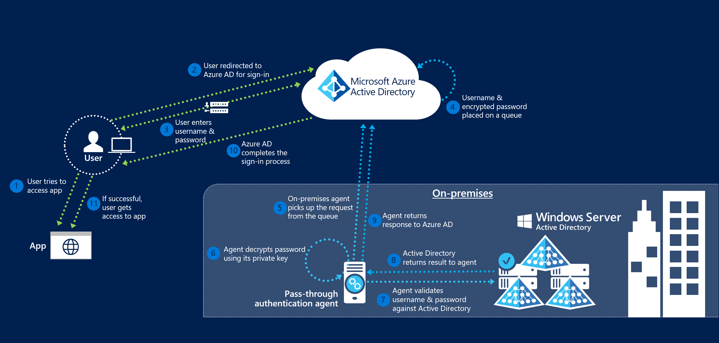
Azure AD Hybrid
Passthrough vs. ADFS
3-14
Notes:
Key benefits of using Azure AD Pass-through Authentication:
Great user experience.
Same passwords to sign into both on-premises and cloud-based applications.
Easy to deploy and administer.
No need for complex on-premises ADFS deployment.
A lightweight agent to be installed on-premises.
No management overhead. Automatic bug fixes.
Secure.
On-premises passwords never stored in the cloud in any form.
The agent only makes outbound connections from within your network. No perimeter required.
20535A
3: Building Azure IaaS-Based Server Applications

Slide 39
Azure AD Domain Services
Azure AD Domain Services integrates previously created Hybrid scenarios or works as a cloud only solution. The benefits are:
Simplicity – few clicks to setup
Integrated – deep Azure AD integration
Compatible – Windows Server AD
Cost-effective – no infrastructure burden
3-14
Notes:
Benefits:
Simple – You can satisfy the identity needs of virtual machines deployed to Azure Infrastructure services with a few simple clicks. You do not need to deploy and manage identity infrastructure in Azure or setup connectivity back to your on-premises identity infrastructure.
Integrated – Azure AD Domain Services is deeply integrated with your Azure AD tenant. You can now use Azure AD as an integrated cloud-based enterprise directory that caters to the needs of both your modern applications and traditional directory-aware applications.
Compatible – Azure AD Domain Services is built on the proven enterprise grade infrastructure of Windows Server Active Directory. Therefore, your applications can rely on a greater degree of compatibility with Windows Server Active Directory features. Not all features available in Windows Server AD are currently available in Azure AD Domain Services. However, available features are compatible with the corresponding Windows Server AD features you rely on in your on-premises infrastructure. The LDAP, Kerberos, NTLM, Group Policy, and domain join capabilities constitute a mature offering that has been tested and refined over various Windows Server releases.
Cost-effective – With Azure AD Domain Services, you can avoid the infrastructure and management burden that is associated with managing identity infrastructure to support traditional directory-aware applications. You can move these applications to Azure Infrastructure Services and benefit from greater savings on operational expenses.
20535A
3: Building Azure IaaS-Based Server Applications

Slide 40
Discussion
What business scenarios would dictate the use of Azure AD Domain Services over a DC box hosted on Azure IaaS or existing metal?
3-15
Notes:
20535A
3: Building Azure IaaS-Based Server Applications

Slide 41
Lab: Deploying Infrastructure Workloads to Azure
Exercise 1: Deploying a Virtual Machine using PowerShell DSC Exercise 2: Deploying a Virtual Machine Scale Set using PowerShell DSC Exercise 3: Cleanup Subscription
Logon Information
Virtual machine: 20535A-SEA-ARCH
User name: Admin
Password: Pa55w.rd
Estimated Time: 60 minutes
Notes:
This lab assumes that students have their own Azure subscriptions that do not contain any existing cloud services, storage accounts, or Azure SQL Database servers.
Azure is continually improving, so the user interface might have been updated since this lab was written. Before students start the lab, make them aware of any differences between the steps described in the lab and the current user interface.
Exercise 1: Deploying a Virtual Machine using PowerShell DSC
Exercise 2: Deploying a Virtual Machine Scale Set using PowerShell DSC
Exercise 3: Cleanup Subscription
20535A
3: Building Azure IaaS-Based Server Applications

Slide 42
Lab Scenario
One of your clients wants to build a web application hosted on Internet Information Services (IIS) that will scale in response to increases and decreases in usage. The solution should minimize the amount of manual setup and maintenance work necessary for each virtual machine running IIS.
Notes:
20535A
3: Building Azure IaaS-Based Server Applications

Slide 43
Lab Review
If you are deploying a farm of web servers Virtual Machines using ARM, when would you use VMSS as opposed to traditional VMs?
Notes:
Question
If you are deploying a farm of web servers Virtual Machines using ARM, when would you use VMSS as opposed to traditional VMs?
Answer
Answers can include:
If all VMs are identical, VMSS is ideal.
If there are differences between VMs, it would be easier to implement them as regular VMs.
20535A
3: Building Azure IaaS-Based Server Applications

Slide 44
Module Review and Takeaways
Review Questions
Notes:
Review Questions
Question
You need to deploy VMs with high availability. You need to ensure that datacenter level failures are protected. How should you deploy your VMs?
( ) Option 1: Availability Zones
( ) Option 2: VNet Peering
( ) Option 3: Azure ASR
( ) Option 4: Availability Set
Answer
( √) Option 1: Availability Zones
( ) Option 2: VNet Peering
( ) Option 3: Azure ASR
( ) Option 4: Availability Set
Question
Which of the following VM Scale Set features is required to build a “large” VM Scale Set instance.
( ) Option 1: Custom Image
( ) Option 2: Managed Disks
( ) Option 3: Static IP Addresses
( ) Option 4: Windows Operating System
( ) Option 5: Storage Accounts
Answer
( ) Option 1: Custom Image
( √) Option 2: Managed Disks
( ) Option 3: Static IP Addresses
( ) Option 4: Windows Operating System
( ) Option 5: Storage Accounts
20535A
3: Building Azure IaaS-Based Server Applications
(More notes on the next slide)

Slide 45
Notes:
Question
You need to ensure that you can apply full Group Policy functionality to multiple OUs in your Azure IaaS Virtual Machines with the least amount of configuration and maintenance effort. All of your Virtual Machines are hosted in your Azure subscription. Which Active Directory Solution should you deploy?
( ) Option 1: Azure AD only
( ) Option 2: Active Directory Domain Services with DC on-premises
( ) Option 3: Active Directory Domain Services deployed to an Azure IaaS VM
( ) Option 4: Azure AD Connect
( ) Option 5: Azure AD Domain Services, Managed Domain
Answer
( ) Option 1: Azure AD only
( ) Option 2: Active Directory Domain Services with DC on-premises
( √) Option 3: Active Directory Domain Services deployed to an Azure IaaS VM
( ) Option 4: Azure AD Connect
( ) Option 5: Azure AD Domain Services, Managed Domain
20535A
3: Building Azure IaaS-Based Server Applications

Slide 46
Lesson 1: Infrastructure-Backed Platform-as-a-Service (PaaS)
Infrastructure Backed PaaS App Service Environments Azure Service Fabric Azure Container Service
4-2
Notes:
20535A
4: Creating Managed Server Applications in Azure

Slide 47
Infrastructure Backed PaaS
Azure provides several services to cater for highly scaled isolated applications:
App Service Environments
Azure Service Fabric
Azure Container Service
4-2
Notes:
Outline all three options and potential use cases.
Very high scale.
Isolation and secure network access.
High memory utilization.
20535A
4: Creating Managed Server Applications in Azure

Slide 48
App Service Environments
Dedicated environment for high scale, secure Apps:
Very high scale
Isolation with secure network access
High memory utilization
Single or Multi region
Deployed to a Virtual Network
An ASE is dedicated exclusively to a single subscription (Max 100 instances)
4-3
Notes:
App Service apps at high scale. For web apps, mobile apps, API apps, and functions.
Multiple ASEs within a single Azure region or across multiple Azure regions.
ASEs are isolated to running only a single customer's applications and are always deployed into a virtual network.
Fine-grained control over inbound and outbound network traffic.
High speed secure VPN connections to corp resources.
Web application firewalls (WAFs) can be used.
Dedicated environment 1 sub 100 instances of a single App service plan or 100 different plans.
Front ends and workers.
Front ends are automatically added as the App Service plans in the ASE are scaled out.
Workers host customer apps.
Three fixed sizes:
One vCPU/3.5 GB RAM
Two vCPU/7 GB RAM
Four vCPU/14 GB RAM
No need to manage front ends and workers.
Expensive options – discuss pricing.
Describe the ASE v1 and ASE v2.
App Service Environment has two versions: ASEv1 and ASEv2.
In ASEv1, you need to manage all of the resources manually.
That includes the front ends, workers, and IP addresses used for IP-based SSL.
20535A
4: Creating Managed Server Applications in Azure
(More notes on the next slide)

Slide 49
Notes:
ASEv1 uses a different pricing model from ASEv2. In ASEv1, you pay for each vCPU allocated.
One advantage to ASEv1 is that it can be deployed in a classic virtual network and a Resource Manager virtual network.
20535A
4: Creating Managed Server Applications in Azure

Slide 50
Azure Service Fabric
Distributed systems platform to package, deploy and manage microservices and containers
Avoids complex infrastructure problems
High density microservice applications running on a shared cluster of machines
Container deployment and orchestration
Stateless and stateful services
4-3
Notes:
Applications composed of microservices.
Container deployment and orchestration.
Any OS, any cloud.
Service Fabric runs everywhere.
For Windows development, the Service Fabric .NET SDK is integrated with Visual Studio and Powershell.
Stateless and stateful microservices for Service Fabric using microservices or containers.
Application lifecycle management – support for full ALM Ci/CD.
Service Fabric is integrated with CI/CD tools such as Visual Studio Team Services, Jenkins, and Octopus Deploy.
20535A
4: Creating Managed Server Applications in Azure

Slide 51
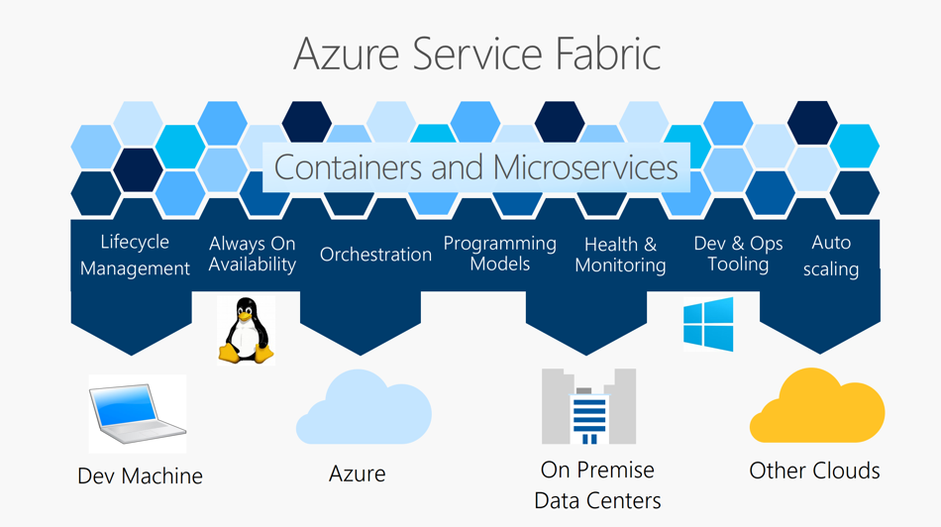
Azure Service Fabric
4-3
Notes:
Key capabilities:
Deploy to Azure or to on-premises datacenters that run Windows or Linux with zero code changes.
Develop scalable applications that are composed of microservices by using the Service Fabric programming models, containers, or any code.
Develop highly reliable stateless and stateful microservices.
Use the novel Reliable Actors programming model to create cloud objects with self contained code and state.
Deploy and orchestrate containers that include Windows containers and Linux containers.
Manage the lifecycle of your applications without any downtime, including breaking and nonbreaking upgrades.
Monitor and diagnose the health of your applications with auto repair.
20535A
4: Creating Managed Server Applications in Azure

Slide 52

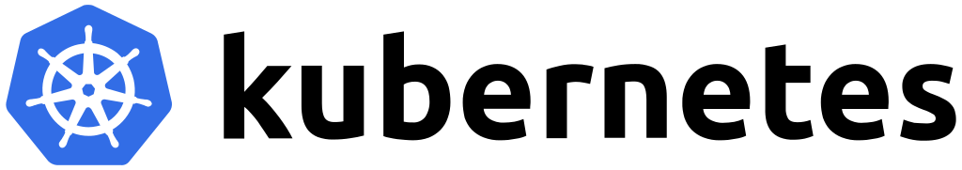
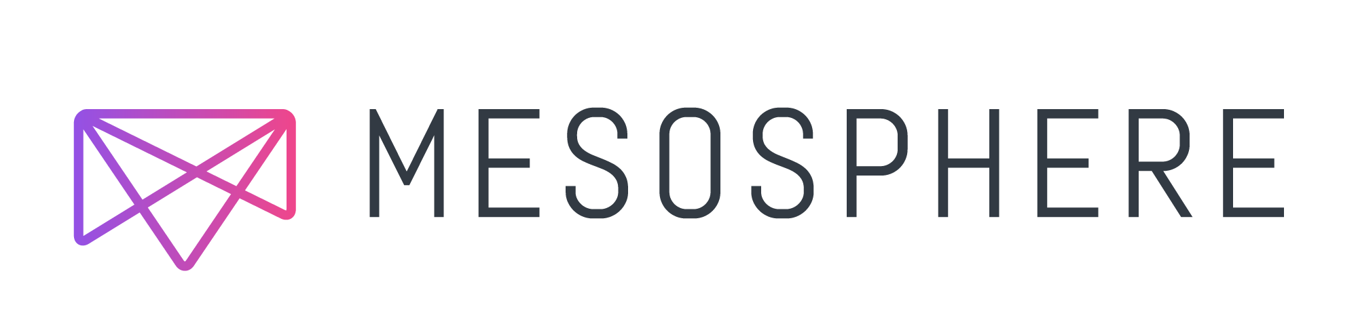
Azure Container Service
Simple management of Cluster of VMs using either Docker, Mesosphere DC/OS or Kubernetes
Removes infrastructure complication and planning
No cluster charges, just used resources
Secure, reliable, highly scalable
4-4
Notes:
Creation, configuration, and management of a cluster of virtual machines that are preconfigured to run containerized applications.
Using an optimized configuration of popular open-source scheduling and orchestration tools.
ACS enables you to use your existing skills or draw upon a large and growing body of community expertise to deploy and manage container-based applications on Microsoft Azure.
ACS leverages Docker images to ensure that your application containers are fully portable.
Supports your choice of Kubernetes, DC/OS (powered by Apache Mesos), or Docker Swarm for orchestration.
Enterprise grade features of Azure while still maintaining application portability.
There are no fees for any of the software installed by default as part of ACS.
ACS is available for Standard A, D, DS, G, GS, F, and FS series Linux virtual machines.
You are only charged for the compute instances you choose, as well as the other underlying infrastructure resources consumed such as storage and networking.
20535A
4: Creating Managed Server Applications in Azure

Slide 53
Discussion
What are some of the benefits and drawbacks of ASE, Service Fabric and ACS?
Notes:
20535A
4: Creating Managed Server Applications in Azure

Slide 54
Module Overview
Azure Web Apps Azure Functions Integration High Performance Hosting
5-1
Notes:
20535A
5: Authoring Serverless Applications in Azure

Slide 55
Lesson 1: Azure Web Apps
Web Apps API Apps
5-2
Notes:
20535A
5: Authoring Serverless Applications in Azure

Slide 56
Web Apps
Web Apps:
Near instant deployment
SSL and Custom Domain Names available in some tiers
WebJobs provide background processing for independent scaling
Can Scale to larger machines without redeploying applications
Virtual Machines:
Need Availability Sets or Load Balancers to prevent simultaneous restarts for maintenance or hardware failures
Additional machines needed for background processing
5-2
Notes:
Recap Web Apps positioning in Azure compared to VMs.
20535A
5: Authoring Serverless Applications in Azure

Slide 57
Web App Deployment
Create Packages:
Continuous Delivery with VSO or GitHub
Can use Team Foundation Version Control (TFVC) or Git for source control
Deployment Slots:
Can create slots such as: Staging, Production, Testing
Web Deploy:
Older IIS Extension method to Export and Import
FTP Deployment
5-2
Notes:
We’re reviewing Web App deployment to justify Web App containers in the next slide.
20535A
5: Authoring Serverless Applications in Azure

Slide 58
Web App for Containers
Deploy applications and solutions that are containerized directly to App Service Web Apps
Simplifies deployment
Matches the already popular container workflow using:
CI/CD with Docker Hub, Azure Container Registry or GitHub
Compatible with existing App Service Features:
Auto-scale, Deployment Slots, etc.
5-2
Notes:
Containers are positioned as a way to streamline the traditional develop-deploy workflow that is strenuous to all teams in an organization.
Web App for Containers can receive the streamlined containers integrating with an existing well-known workflow.
20535A
5: Authoring Serverless Applications in Azure

Slide 59
Container Orchestration
Containers can be sourced from your existing registries
Docker Hub:
Deploy images already shared on Docker Hub
Deploy the most popular official images
Private images are available on Docker Hub
Azure Container Registry:
Managed service for hosting Docker images
Can deploy to Docker Swarm, Kubernetes or Web App for Containers
5-2
Notes:
20535A
5: Authoring Serverless Applications in Azure

Slide 60
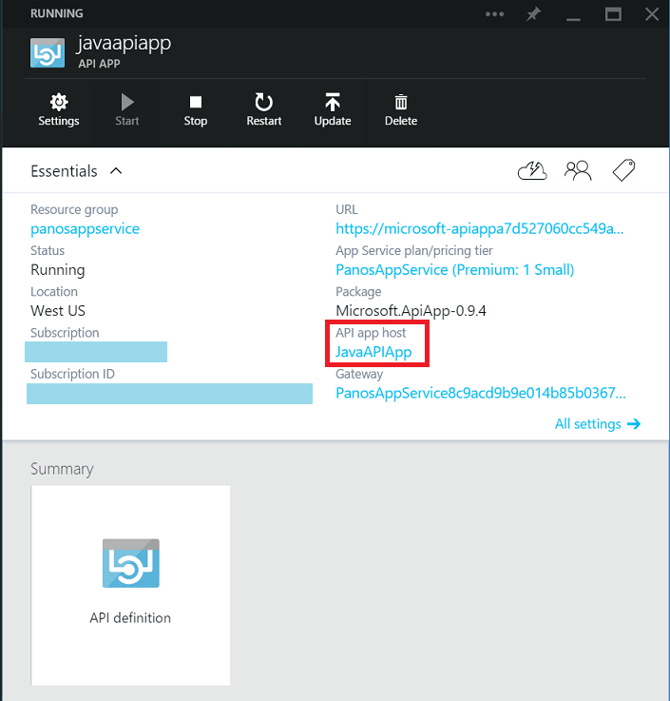
API Apps
Quickly implement Custom APIs:
Publish to External, Partner and Internal developers
Extend Operations for data and services:
Each API can have 1 or more operations
API Apps can be integrated into Logic App workflows
5-3
Notes:
API Apps are specialized version of Web Apps used specifically to host REST APIs.
20535A
5: Authoring Serverless Applications in Azure

Slide 61
Discussion
How would your team make the decision to use public or private Docker containers?
Notes:
It’s easy for students to say that “all corporate assets must be private.”
Throw a curveball by asking them to consider using well-known public images to save effort and time instead of authoring new images. For example, they can use the well-known ASP.NET Core image as a starting point for their application.
20535A
5: Authoring Serverless Applications in Azure

Slide 62
Lesson 2: Azure Functions
Serverless Processing Event-Based Triggers
5-5
Notes:
20535A
5: Authoring Serverless Applications in Azure

Slide 63
Serverless Processing
Many compute tasks vary in their consumption:
Sometimes the compute units are unused or unnecessary
The compute must be around to respond to bursts in usage
Traditional compute models use auto-scale and metrics to try and better prioritize compute spend based on utilization:
The compute spend never “exactly” matches the utilization
5-5
Notes:
Line = How much you have provisioned or paying for (always account for overhead and over-provisioning).
Rectangles = Actual utilization.
We talk about the space between the utilization and the line as “lost money” due to servers not having psychic powers.
20535A
5: Authoring Serverless Applications in Azure

Slide 64
Serverless Services
Serverless refers to services that offer consumption-based billing where you only pay for services you consume
5-5
Notes:
Billing matches utilization almost exactly.
20535A
5: Authoring Serverless Applications in Azure

Slide 65
Azure Functions
Azure Functions:
Build on WebJobs Technology
Available in Consumption and App Service Plan billing modes
Can be deployed using Scripts or Pre-Compiled
Managed and Edited directly in the portal:
Supports CI from GitHub or VSO if preferred
5-5
Notes:
Talk about how WebJobs evolved to Functions.
Position Functions against the closest competitor, AWS Lambda.
20535A
5: Authoring Serverless Applications in Azure

Slide 66
Azure Functions Features
Functions support a wide variety of programming languages:
C#
F#
Node.js
Java
PHP
Python
Functions also support scripting languages:
Bash
PowerShell
5-5
Notes:
20535A
5: Authoring Serverless Applications in Azure

Slide 67
Event-Based Triggers
Azure Functions features no-code triggers that can invoke a function based on changes in the following services:
Azure:
Storage Blobs
Cosmos DB
Storage Tables
Mobile Apps
Office 365 Files
Third-Party:
Twilio
SendGrid
5-6
Notes:
20535A
5: Authoring Serverless Applications in Azure

Slide 68
Messaging Triggers
Azure Functions can also integrate into existing workflows that use Azure messaging services:
Service Bus
Event Grid
Storage Queues
Event Hubs
5-6
Notes:
For each service, give an example of an integration that may make sense.
Example: An event hub message can trigger an Azure Function that performs additional processing on the message.
20535A
5: Authoring Serverless Applications in Azure

Slide 69
Discussion
What could you use a Bash or PowerShell Azure Function for?
Notes:
Immediate example could be an Azure Function that is triggered by Event Grid whenever a resource group deployment is complete to add tag metadata to the resource group using PowerShell and the Azure PowerShell module.
20535A
5: Authoring Serverless Applications in Azure

Slide 70
Lesson 3: Integration
API Management Logic Apps
5-7
Notes:
20535A
5: Authoring Serverless Applications in Azure

Slide 71
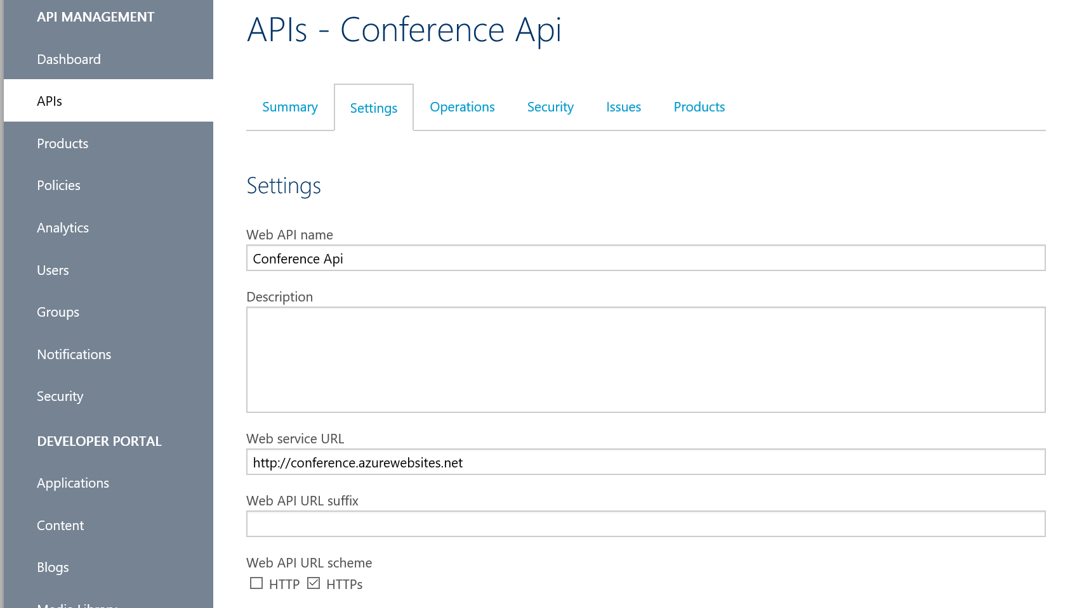
API Management
API Proxy Service:
Protect your API Endpoints
Add billing, throttling, monitoring and policies to existing APIs without changing their code
Manipulate requests and responses in-flight to meet business requirements
5-7
Notes:
20535A
5: Authoring Serverless Applications in Azure

Slide 72
Logic Apps
Automation workflow solution:
No-code designer for rapid creation of integration solutions
Pre-built templates to simplify getting started
Out-of-box support for popular SaaS and on-premises integrations
BizTalk APIs available to advanced integration solutions
JSON-based workflow definition:
Can be deployed using ARM templates
5-7
Notes:
Logic apps are designed for code-free or code-minimal automation and integration scenarios.
They provide:
No code designer for rapid creation of integration solutions.
Dozens of pre-built templates to get started.
Out of box support for popular SaaS and on-premises apps.
Use with custom API apps of your own.
Biztalk APIs for expert integration scenarios.
20535A
5: Authoring Serverless Applications in Azure

Slide 73
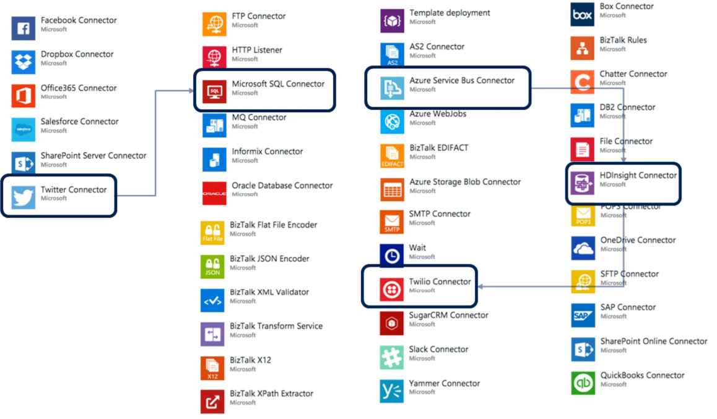
Logic App Connectors
5-8
Notes:
You can think of Logic Apps as being like toy bricks for integration- you select your bricks and snap together an app.
For example, you could use the Twitter Connector to read tweets of interest and write them to SQL Database using the Microsoft SQL Connector.
Or, you could use the Azure Service Bus Connector to queue processing that you will run on HDInsight against some big data, and then send the result via an SMS message using the Twilio connector.
All of this is performed by configuring the connectors, declaratively instead of by writing code.
20535A
5: Authoring Serverless Applications in Azure

Slide 74
Logic App Components
Workflow:
The business process described as a series of steps
Triggers:
The step that invokes a new workflow instance
Actions:
A individual step in a workflow, typically a Connector or custom API App
Connectors:
A special case of an API App that is pre-built and ready to integrate with a specific service or data source:
For example: Twitter and SQL Server Connectors
5-8
Notes:
The main components of a Logic App are as follows:
Workflow: The business process described as a series of steps, in an acyclic graph (loops are not supported).
Triggers: The step that starts a new workflow instance.
Actions: A step in a workflow, typically a Connector or a custom API App.
Connector: A special case of API App ready made to integrate a specific service (e.g. Twitter) or data source (e.g. SQL Server).
20535A
5: Authoring Serverless Applications in Azure

Slide 75
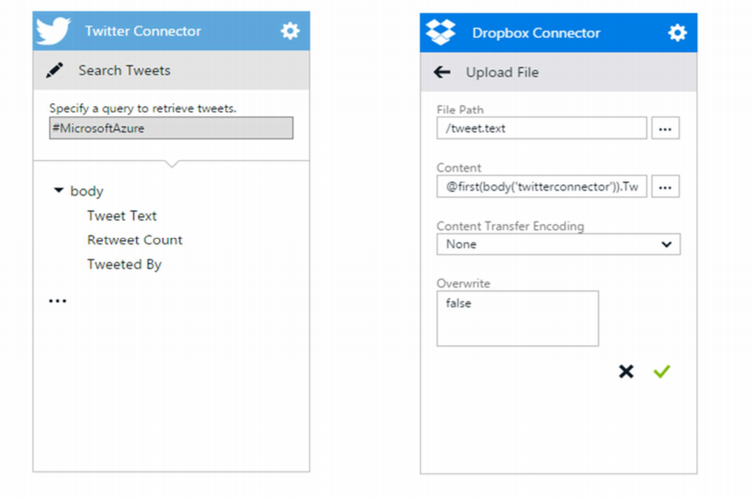
Example Logic App
5-8
Notes:
Explain to the students how the Twitter Connector triggers the workflow and the Dropbox connector stores the content of the Tweet as a text file.
20535A
5: Authoring Serverless Applications in Azure

Slide 76
API Apps in Logic Apps
Any API App can be used as a first-class Action in a Logic App Workflow
5-8
Notes:
The connectors to SaaS and on-premises apps are simply API Apps that are integrated by Logic Apps as first-class citizens.
20535A
5: Authoring Serverless Applications in Azure

Slide 77
Discussion
Are there any business reasons to use API Management to manipulate the response of your REST API?
Notes:
You can strip out headers that expose implementation information about your REST API. For example, your application can use an API Management proxy instead of Azure Search directly so that you can strip out your Azure Search account-specific information in headers and the response.
You can also manipulate the response from your API to meet a specific standard required by a client app or mobile device.
20535A
5: Authoring Serverless Applications in Azure

Slide 78
Lesson 4: High Performance Hosting
Best Practices Basic Web Application Scaling Traffic Manager
5-9
Notes:
20535A
5: Authoring Serverless Applications in Azure

Slide 79
Best Practices
In a multi-tier model create each tier in a separate App Service Tier
Create Deployment slots in separate App Service Tiers
Make use of the VNET Integration with service end-points to SQL Databases and Storage Accounts
Distribute your application across Azure regions and use Traffic Manager to manage it
5-9
Notes:
20535A
5: Authoring Serverless Applications in Azure

Slide 80
Basic Web Application
5-9
Notes:
We can start with a very basic design for our application.
This architecture contains a Web App and a SQL Database within a resource group using Azure AD for authentication.
It’s also a recommendation to host both the app services as the SQL database in the same Azure region in order to minimize network latency.
20535A
5: Authoring Serverless Applications in Azure

Slide 81
Scaling
Horizontal scaling allows you to create a multi-instance app
Performance and reliability
Have always at least 2 instances
App Service can scale up to 100 Instances:
Basic tier: up to 3 instances (only manual scaling)
Standard tier: up to 10 instances
Premium and PremiumV2 tier: up to 20 instances
Isolated tier: up to 100 instances
5-10
Notes:
20535A
5: Authoring Serverless Applications in Azure

Slide 82
Scaling
5-10
Notes:
20535A
5: Authoring Serverless Applications in Azure

Slide 83
Traffic Manager
Allows to control user traffic distribution
Endpoints can include:
App Services
Cloud Services (Legacy)
Other endpoints (even on-premises with internet connection)
Can be used in several modes:
Failover
Geography
Distribution
5-10
Notes:
20535A
5: Authoring Serverless Applications in Azure

Slide 84
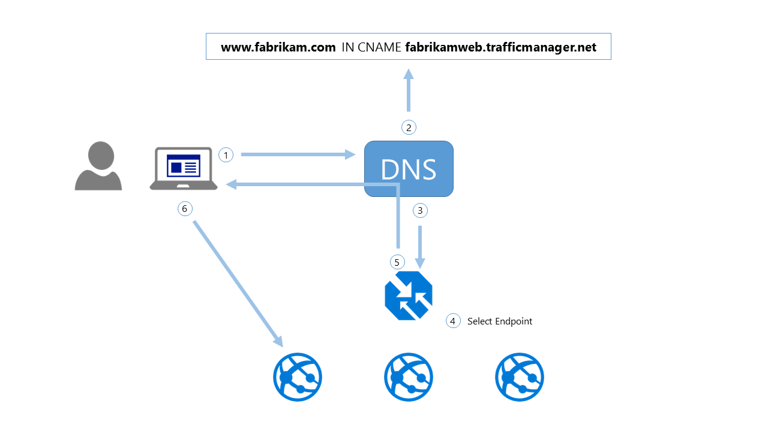
Traffic Manager
5-10
Notes:
User uses the custom DNS name to request a website.
Azure routes the custom DNS name to the actual DNS name at *.trafficmanager.net.
The actual DNS routes the request to Traffic Manager.
Traffic Manager picks the correct endpoint based on algorithm.
The user is returned the data from the correct endpoint.
Follow-up requests from the user will go directly to the correct endpoint.
20535A
5: Authoring Serverless Applications in Azure

Slide 85
Multi-Region Model
Primary and secondary regions:
Choose regions from the same regional pair (Example: East US 2 and Central US)
Azure Traffic Manager
Geo-replication of data (SQL Database or/and Cosmos DB)
5-10
Notes:
20535A
5: Authoring Serverless Applications in Azure

Slide 86
Multi-Region Model
5-10
Notes:
Multi-region deployment using Traffic Manager.
20535A
5: Authoring Serverless Applications in Azure

Slide 87
Discussion
How could you use Azure CDN and Traffic Manager to create a “fast” experience for global users of your application?
Notes:
App Service: Standard Tier, in order to scale automatically.
Traffic Manager, to create a load balancer.
Redis Cache, to have a common and state of the art cache system. Redis works as a Service, so it’s implement in a very fast pace.
CDN: Implementing CDN network will allow users to be served more close to their locations, so, it will reduce the load time of our application.
20535A
5: Authoring Serverless Applications in Azure

